Slide 1
QGIS
Quantum Geographic Information System

Slide 2
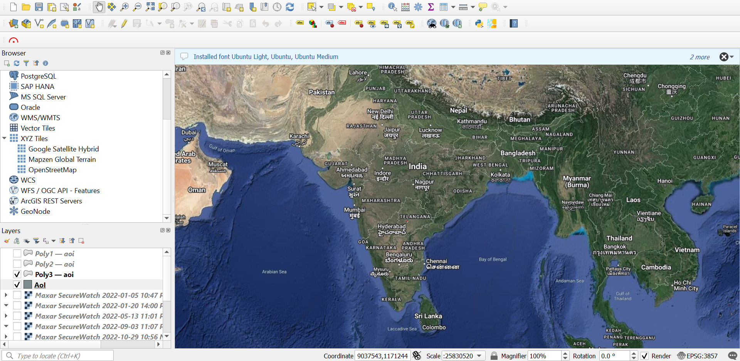
Adding Google maps to QGIS
Google Satellite Hybrid:
https://mt1.google.com/vt/lyrs=y&x={x}&y={y}&z={z}
Google Satellite:
http://www.google.cn/maps/vt?lyrs=s@189&gl=cn&x={x}&y={y}&z={z}
Google Maps:
https://mt1.google.com/vt/lyrs=r&x={x}&y={y}&z={z}

Slide 3
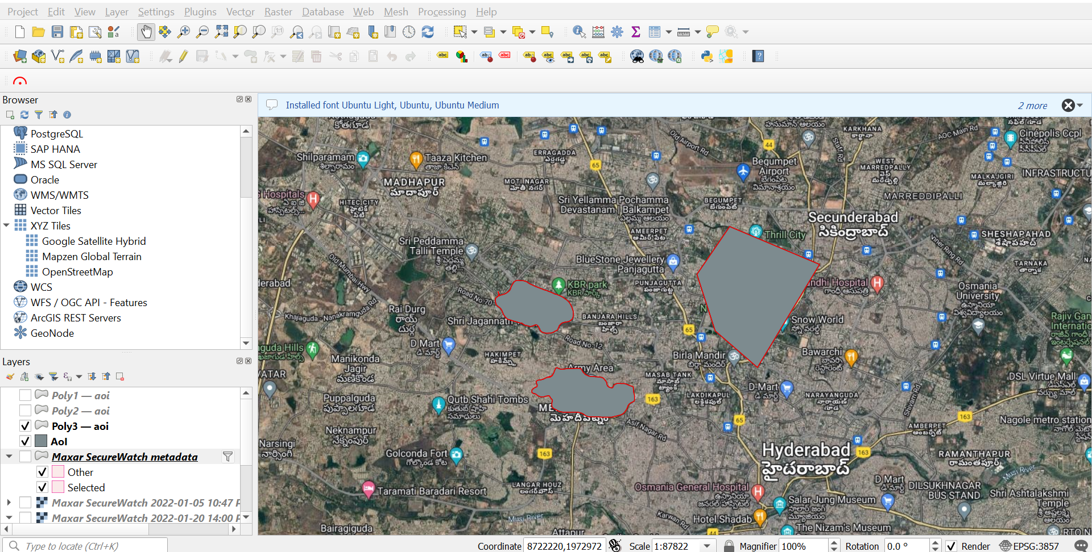
Polygon shape Creation

Slide 4
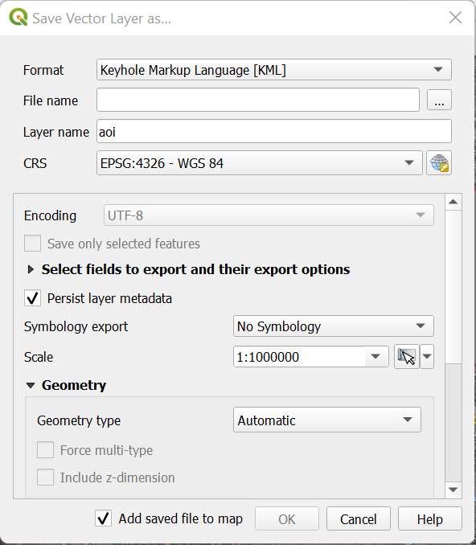
Saving the Polygon
Can be saved in multiple formats like
KML
GeoJSON
ESRI Shapefile

Slide 5
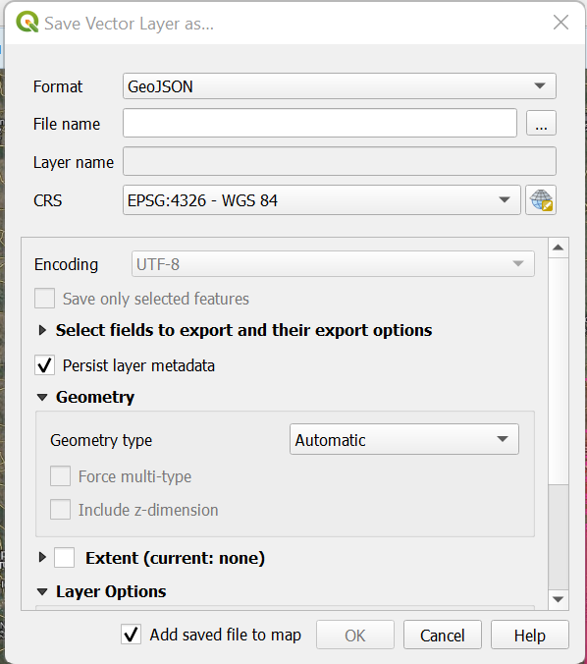
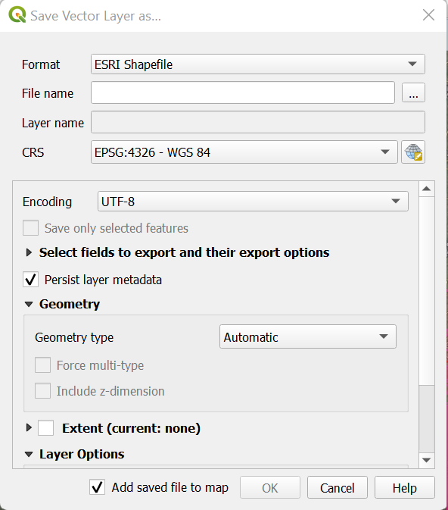
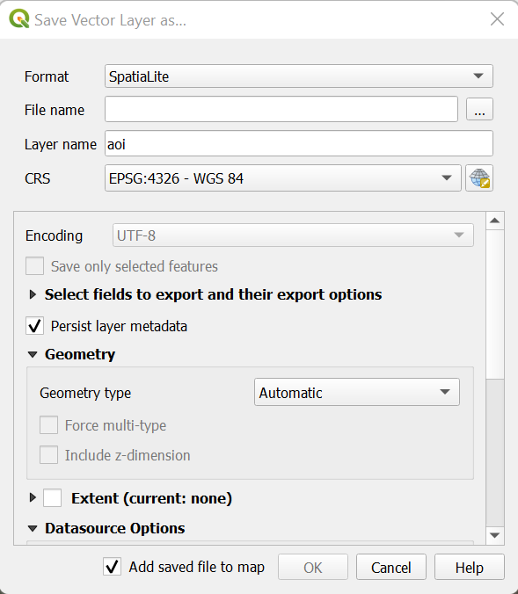
Other formats to save Polygon

Slide 6
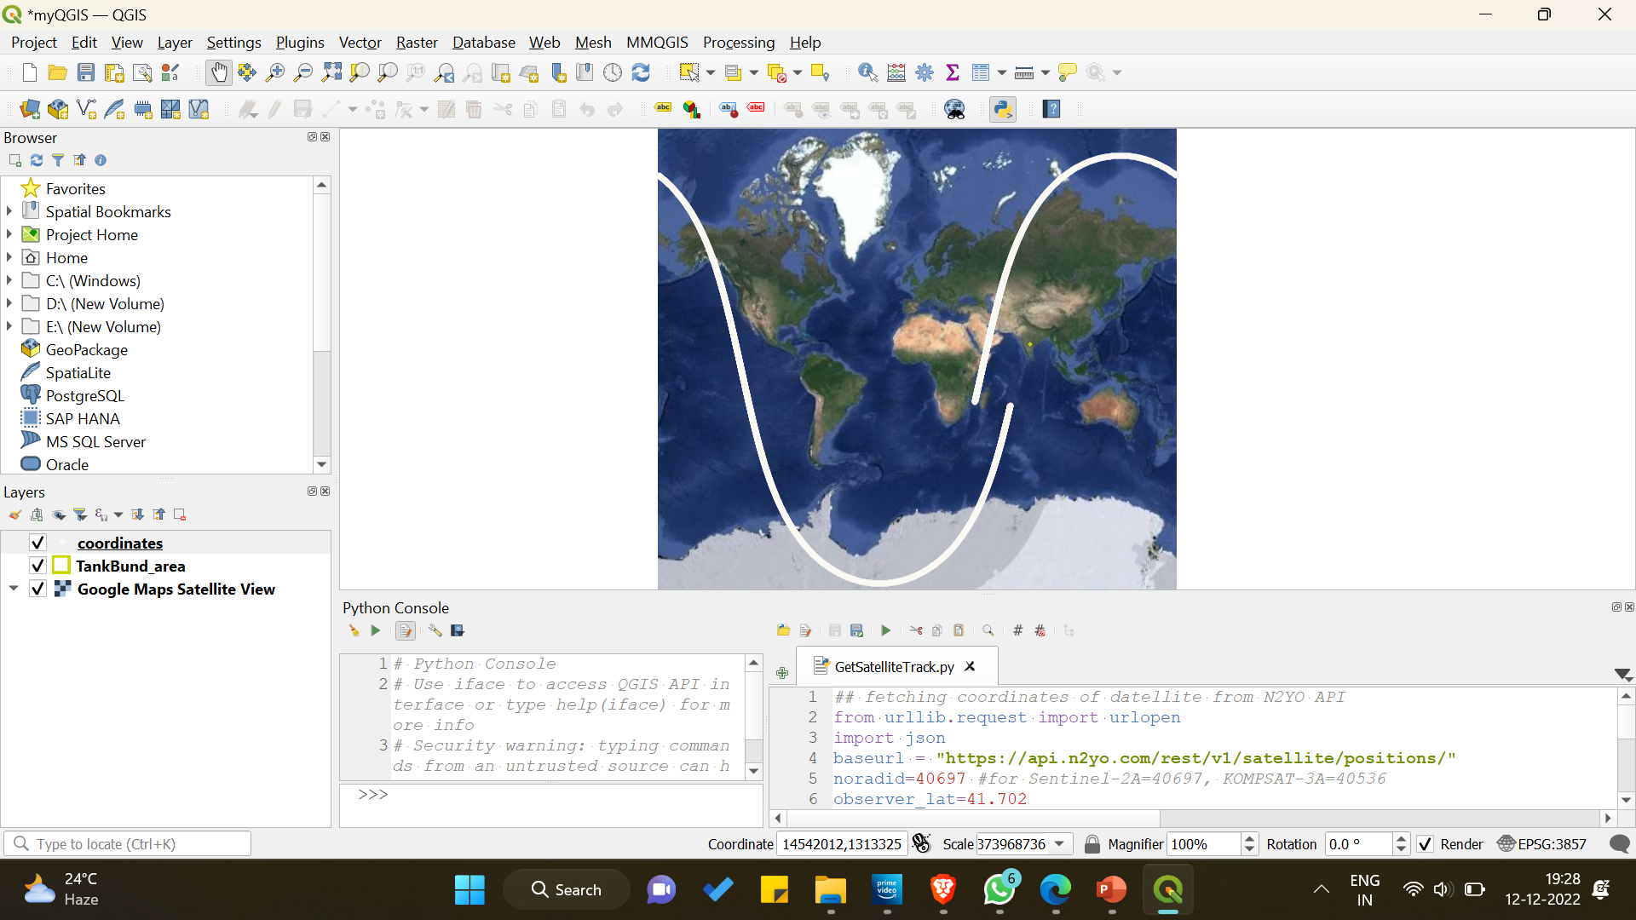
Adding Satellite Orbit Tracking To QGIS

Slide 7
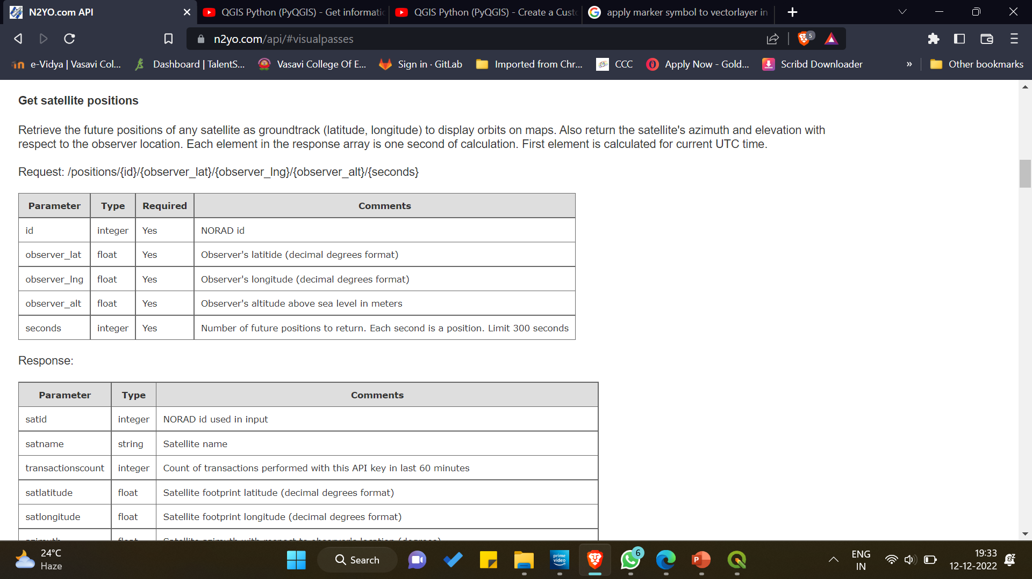
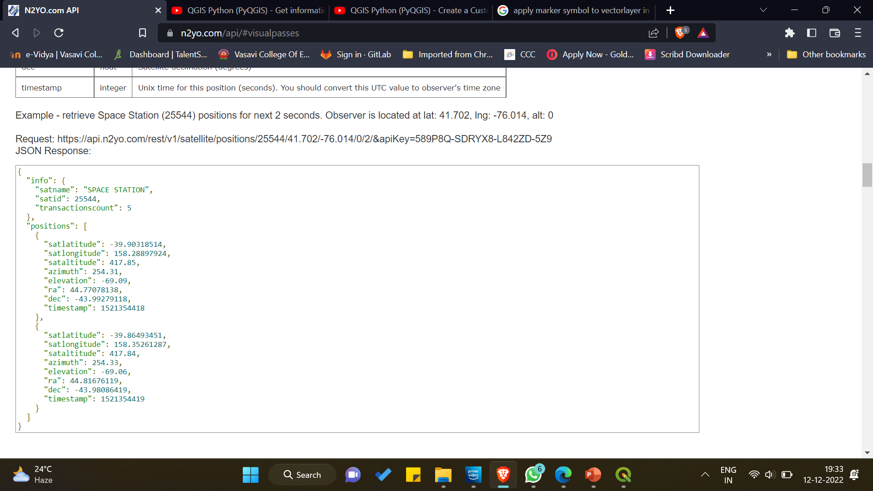
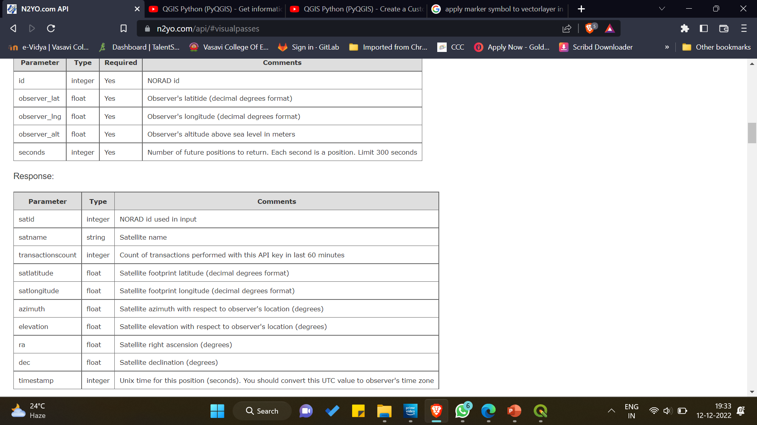
N2YO.COM API
URL: https://www.n2yo.com/api/#positions

Slide 8
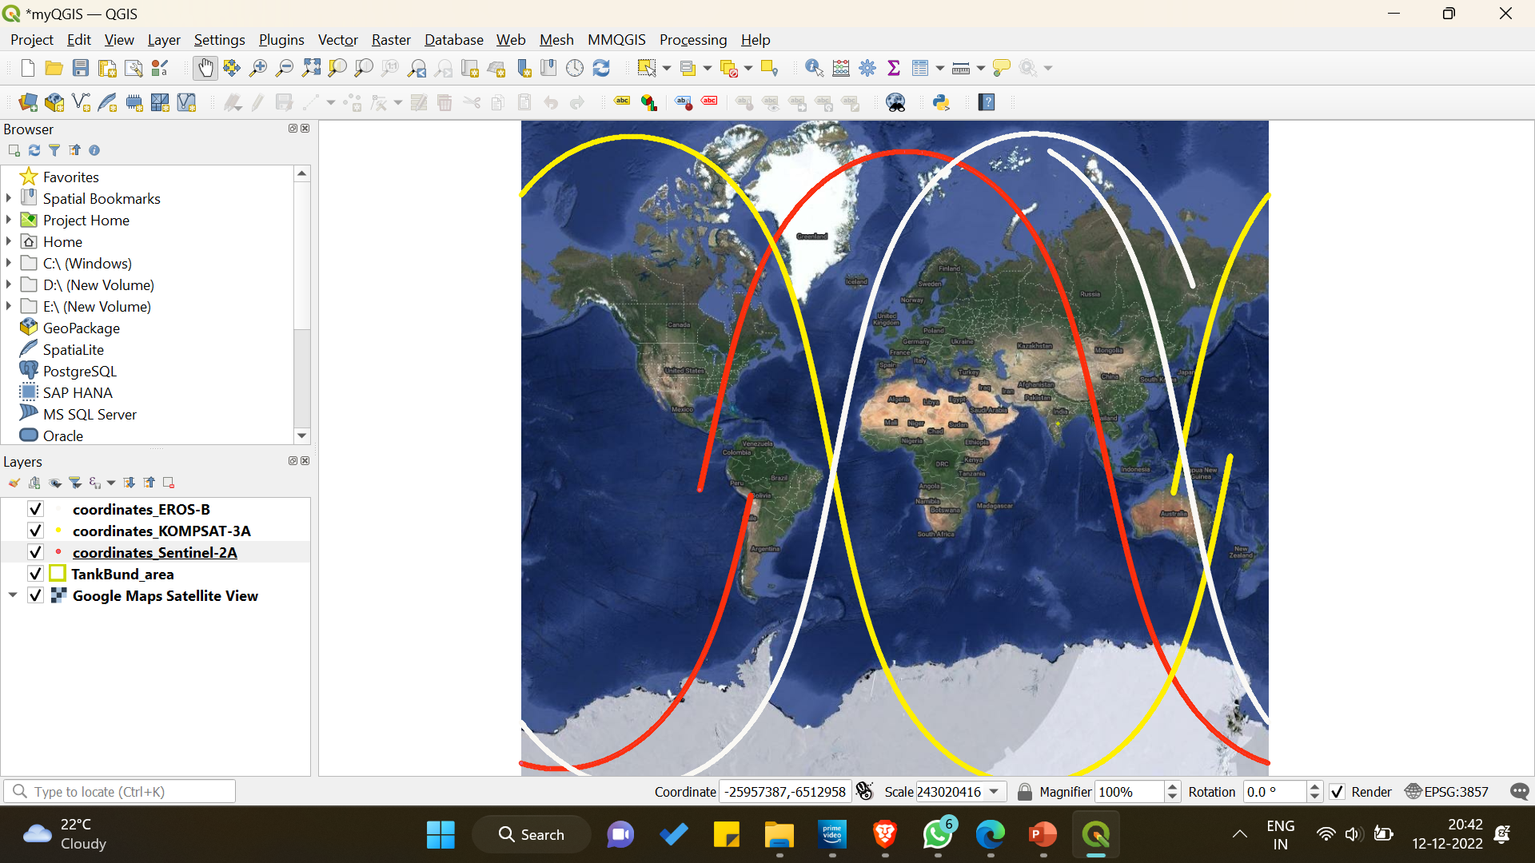
Multiple Satellite Orbit Tracks

